Slide 1

Engineering MATHEMATICS –I
UNIT-II
Lecture-1
Introduction to First Order Ordinary Differential Equations

Slide 2
SYLLABUS
UNIT-II
ORDINARY DIFFERENTIAL EQUATIONS OF FIRST ORDER AND DEGREE
Exact & Non-Exact Differential Equation
Linear Differential Equation
Bernoulli’s Equation

Slide 3
Applications:
Newton’s Law of cooling
Law of Natural growth and Decay

Slide 4
INTRODUCTION
Differential equations are of fundamental importance in engineering because most of the physical laws and relations appear mathematically are in the form of differential equations.
For engineers the purpose of learning the theory of differential equations is to be able to solve practical problems where differential equations are used.

Slide 5
Applications of Differential Equations
Differential Equations have wide applications in various engineering and science disciplines. In general, modeling of the variation of physical quantity, such as temperature, pressure, displacement, velocity, stress, strain, current, voltage or concentration of a pollutant, with the change of time or location or both would result in the differential equations.

Slide 6
Similarly, studying the variation of some physical quantities on other physical quantities would also lead to differential equations.
In fact many engineering subjects, such as mechanical vibration or structural dynamics, heat transfer, theory of electric circuits are founded on the theory of differential equations.

Slide 7
Definition of differential equation
An equation involving differential coefficients is called a differential equation.
dy/dx = sinx ….(1)
∂z/ ∂x + ∂z/ ∂y =0 ….(2)
are differential equations.

Slide 8
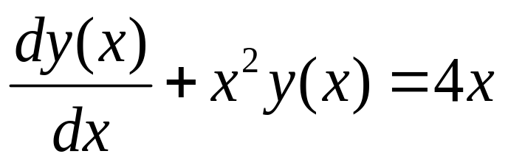
Classification of differential equations
(1) Ordinary Differential equations
An ordinary differential equation (ODE) involves only one independent variable and contains only total differentials.

Slide 9
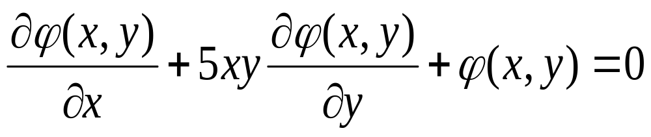
(2) Partial Differential equations
A partial differential equation (PDE) involves more than one independent variable and contains partial differentials.

Slide 10
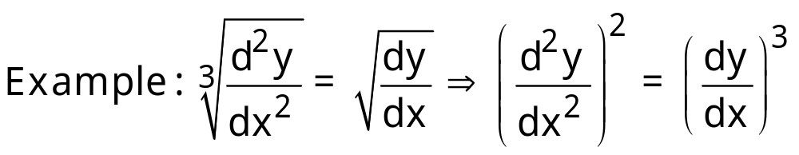
Order of the Differential Equation
The order of a differential equation is the order of the highest order derivative occurring in the differential equation.
The order of the highest order derivative is 2
Therefore, order is 2

Slide 11
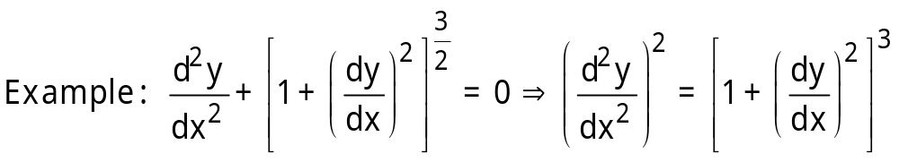
Degree of the Differential Equation
The degree of a differential equation is the degree of the highest order derivative, when differential coefficients are made free from fractions and radicals.
The degree of the highest order derivative is 2.
Therefore, degree is 2.

Slide 12
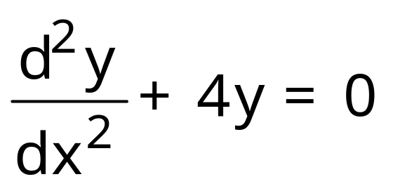
Solution of a Differential Equation
The solution of a differential equation is the relation between the variables, free from differential coefficients, satisfying the given differential equation.
For Example : y = Acos2x – Bsin2x is a solution of the differential equation

Slide 13
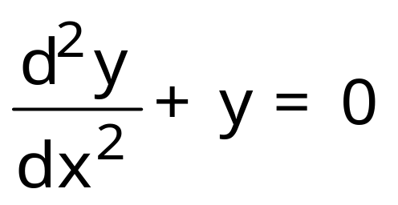
General Solution
If the solution of a differential equation of nth order contains n arbitrary constants, then solution is called the general solution.
y = Acosx – Bsinx is the general solution of the differential equation
Whereas y=-Bsinx is not the general solution as it contains only one arbitrary constant.

Slide 14
Particular Solution
A solution obtained by giving particular values to the arbitrary constants in general solution is called particular solution.
y = 3cosx – 2sinx is a particular solution of the differential equation

Slide 15
Formation of a differential equation
Ordinary differential equations are formed by the elimination of arbitrary constants.
In general, elimination of n arbitrary constants will give rise to a differential of the nth order.
For example, to eliminate two arbitrary constants, we require two more equations besides the given equation, which are obtained by differentiating the solution for two times leading us to second order derivatives and hence a differential equation of the second order.

Slide 16
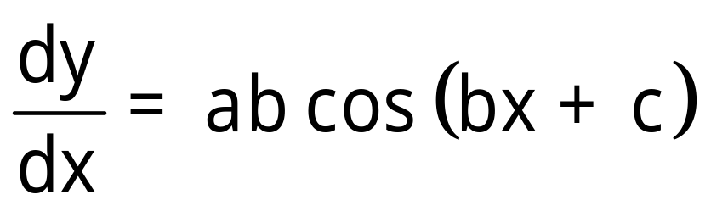
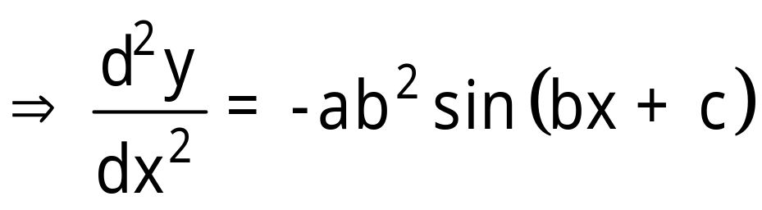
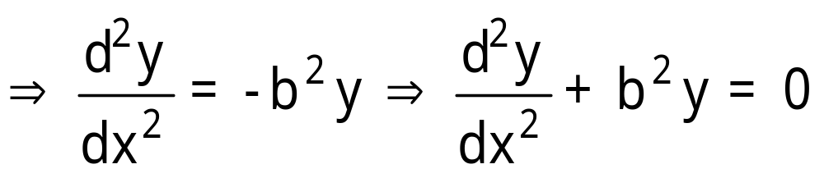
Example : Form the differential equation of the family of curves y = a sin(bx+c) where a and c being parameters.
Solution: We have y = a sin(bx+c)
is the required differential equation.
[Differentiating w.r.t. x]
[Differentiating w.r.t. x]

Slide 17
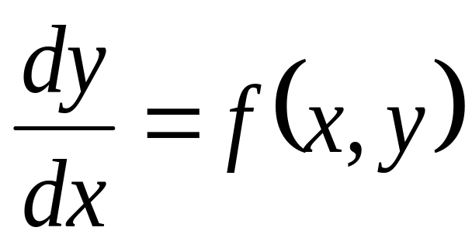
FIRST ORDER AND FIRST DEGREE DIFFERENTIAL EQUATION:
The general form of first order and first degree differential equation is
OR
M(x, y)dx + N(x, y)dy = 0

Slide 18
The first order and first degree differential equation can be classified as below
Variable separable
Homogenous differential equation and the equation can be reduced to homogenous(non-homogenous)
Exact differential equation and the equation can be made exact by using integrating factor (non-exact)
Linear and Bernoulli differential equation

Slide 19
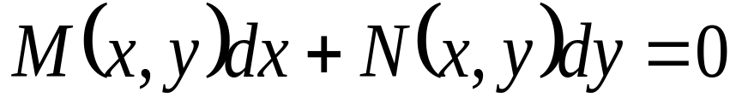
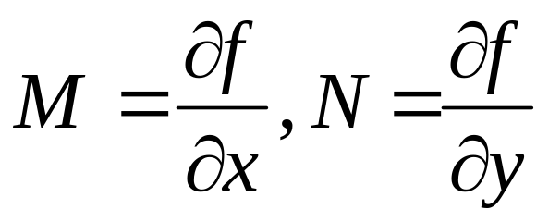
EXACT DIFFERENTIAL EQUATION
A differential equation of the form
is said to be exact differential equation if there exist a function f(x, y) such that
where M and N are continuous functions in x, y.

Slide 20
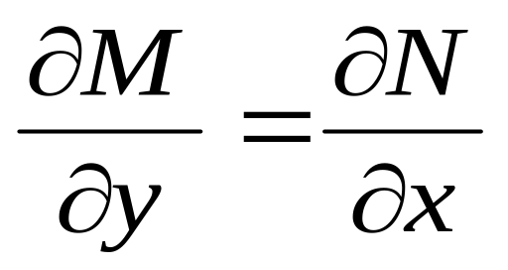
Condition for Exact Differential Equation
The necessary and sufficient condition for M(x,y)dx + N(x,y)dy to be an exact differential equation is

Slide 21
Working Rule:
Step 1:
Check the condition for Exact Differential Equation.
Compare the given problem with M(x,y)dx+N(x, y)dy and verify the condition
if it satisfies then proceed to step 2.

Slide 22
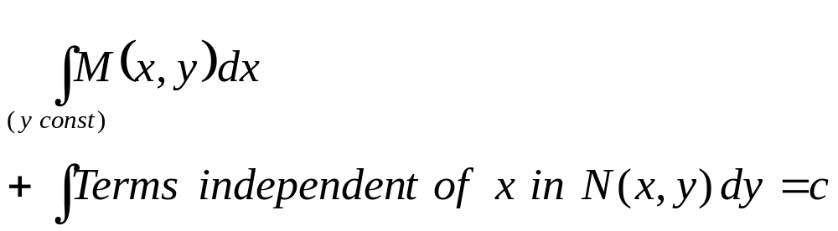
Step 2: General Solution

Slide 23
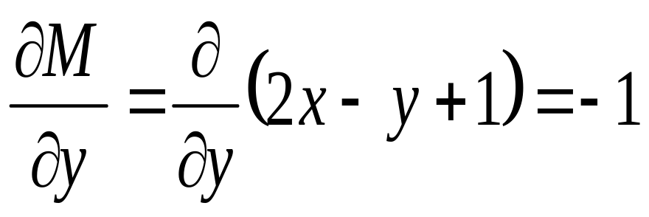
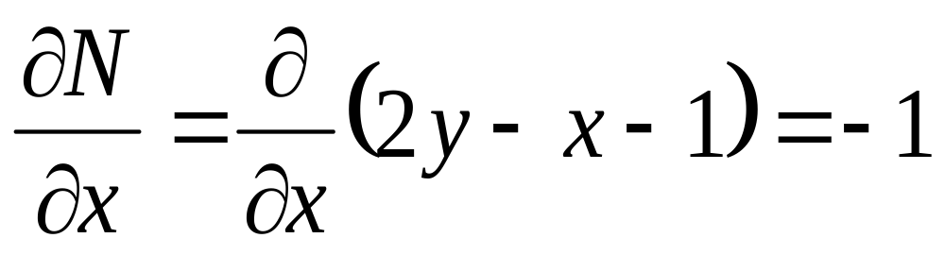
Example 1. Solve (2x – y + 1) dx + (2y – x - 1)dy =0
Solution: Comparing with the standard form
we have M = (2x – y + 1) and N = (2y – x - 1)
Verify the condition for the exact ness
Therefore

Slide 24
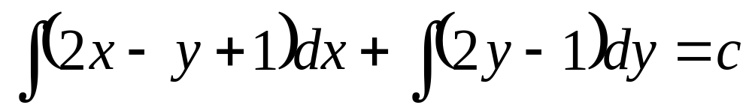
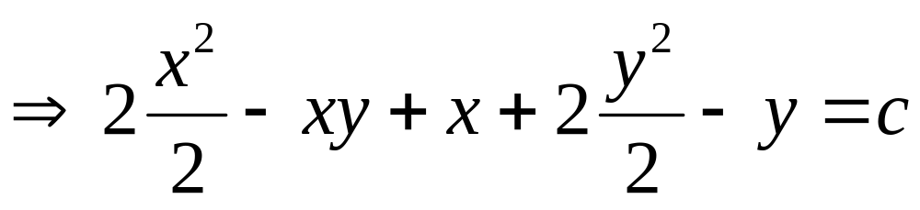
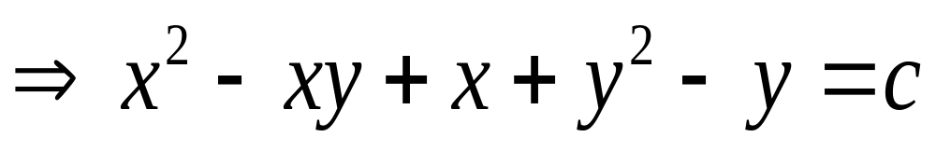
So , the given D.E. is an exact differential equation and the general solution is given by

Slide 25
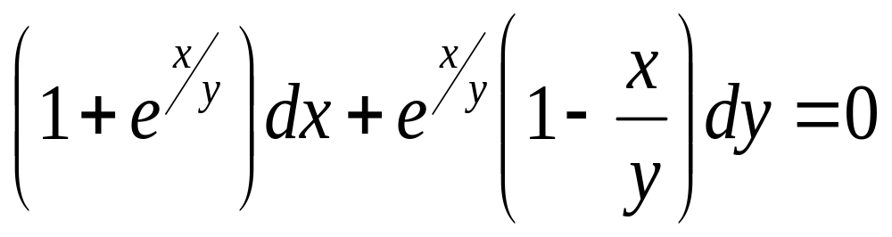
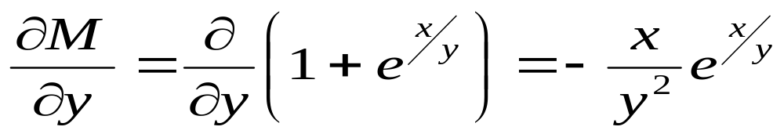
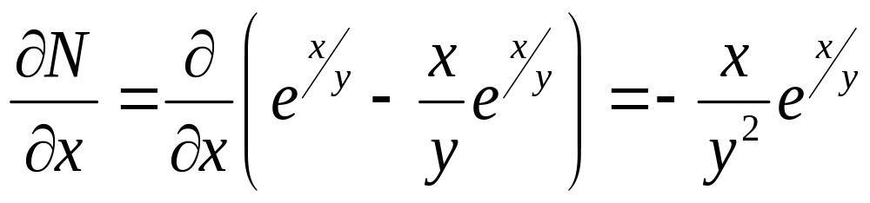
Example 2. Solve
Solution: Verify the condition for the exact ness
Therefore

Slide 26
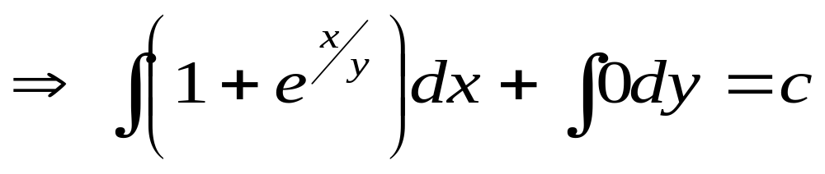
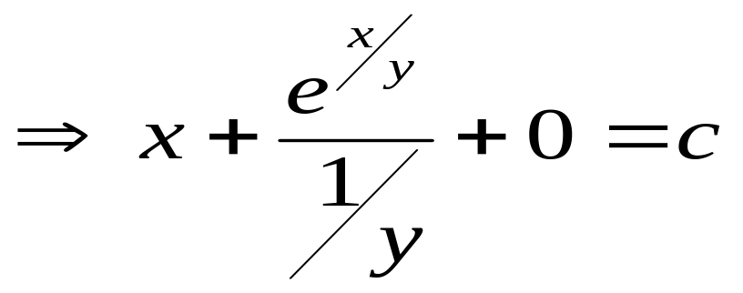
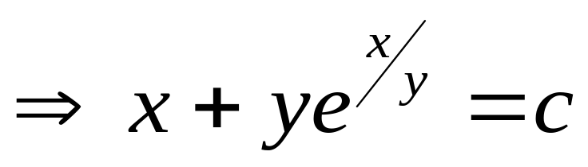
So, the given D.E. is an exact differential equation.
Then the general solution is given by

Slide 27
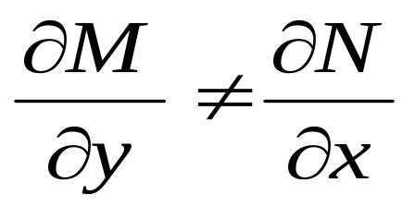
Equations Reducible to exact form:
Sometimes a D.E. which is not exact i.e. can be made exact by multiplying with a suitable factor called Integrating factor.

Slide 28
INTEGRATING FACTOR:
A factor u(x, y) which when multiplied to a non-Exact Differential equation makes it an Exact Differential equation is called as Integrating factor.
NOTE: For every non-exact differential equation, if Integrating factor exist, then it need not be unique.

Slide 29
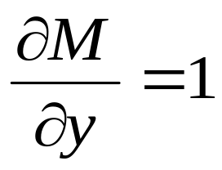
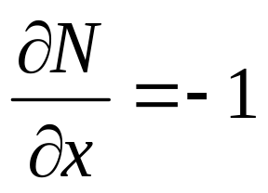
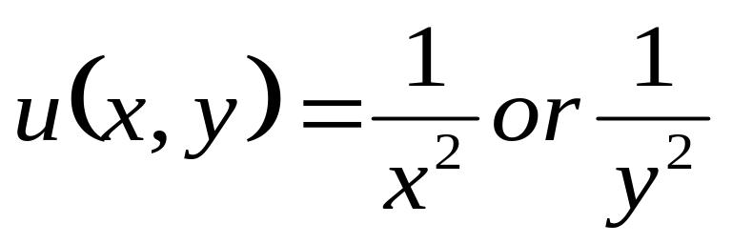
Example: Consider ydx – xdy = 0
Solution: Given ydx – xdy = 0 --(1)
Here M = y and N = -x
Therefore the given D.E. is non-exact.
Multiply (1) on both sides with

Slide 30
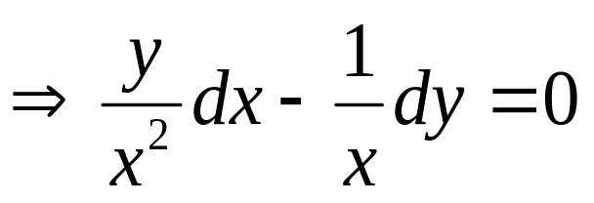
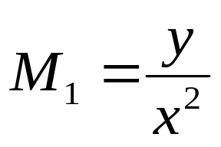
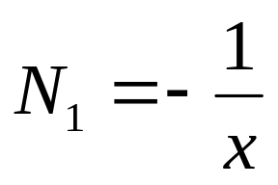
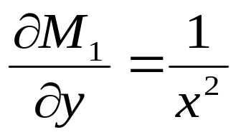
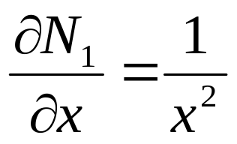
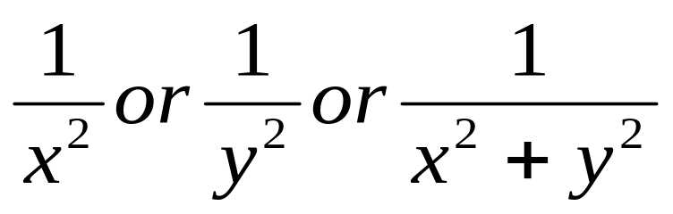
Eq. (1) is a exact differential equation.
So, are the integrating factors for the
given D.E.

Slide 31
Methods of Finding Integrating Factors:
Type I : By Inspection or Formula Type
In this method integrating factor is determined by the arrangement of terms in the equation noting that each group is a part of the exact differential equation.
In this method the following total differentials can be frequently used.

Slide 32
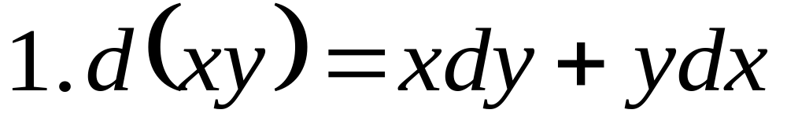
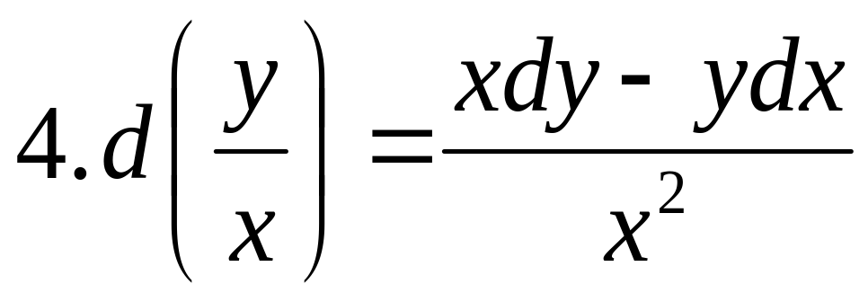
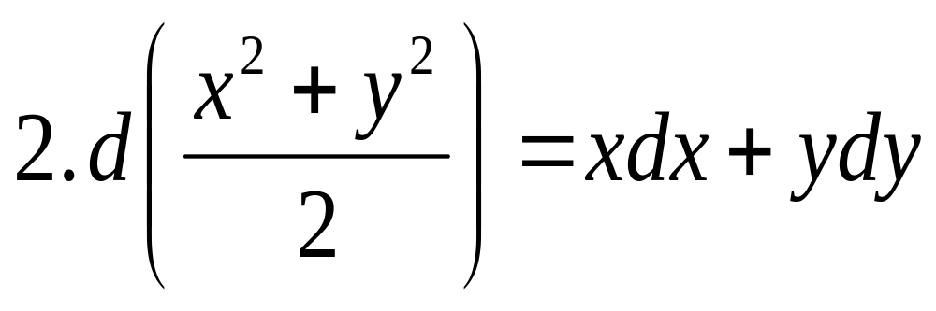
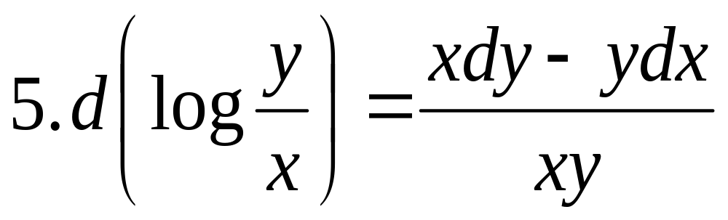
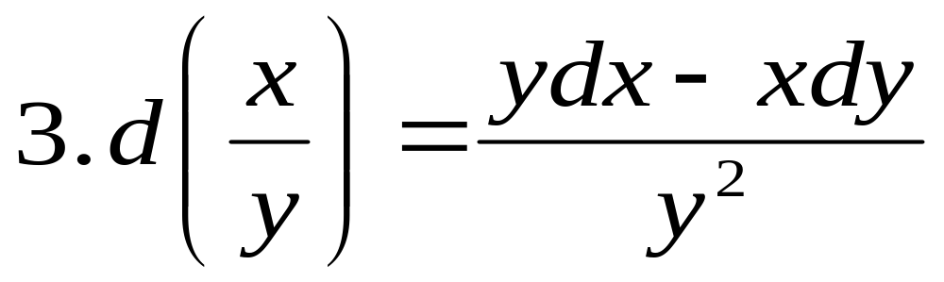

Slide 33
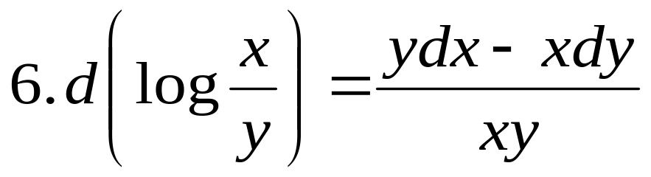
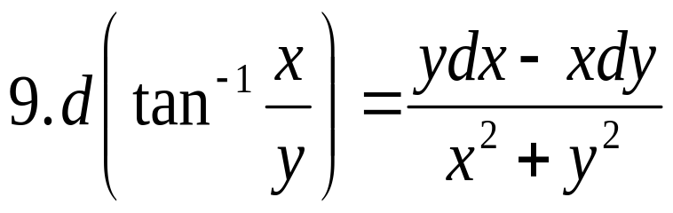
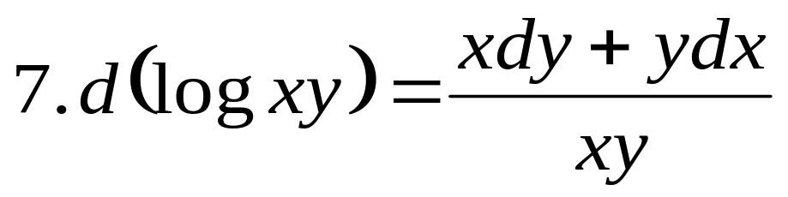
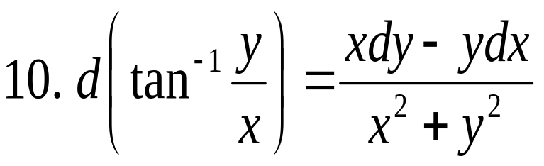
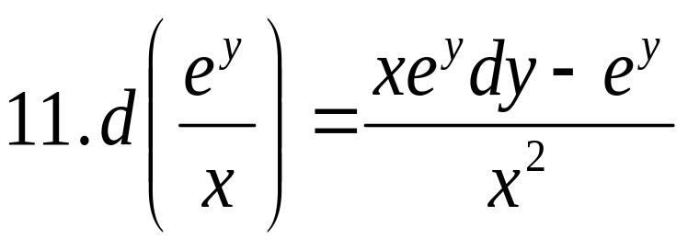
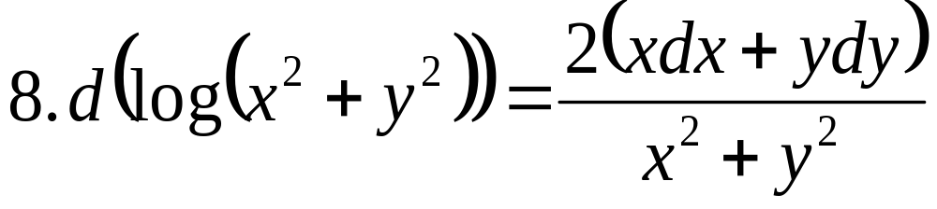
.

Slide 34
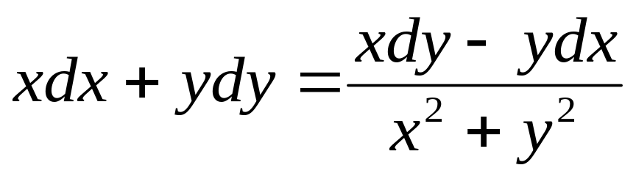
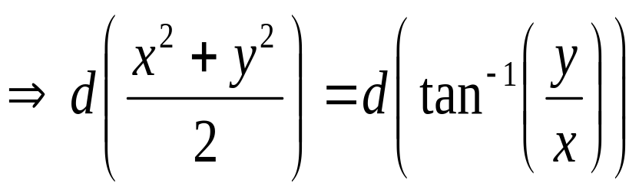
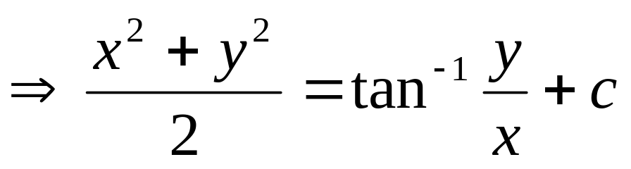
Example 1: Solve
Solution: Using the total differentials the given equation can be expressed as
Integrating on both sides we obtain

Slide 35
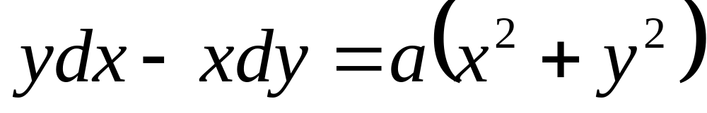



Example 2: Solve
Solution : Given equation can be expressed as
Integrating on both sides we obtain,

Slide 36

Type – II:
Let M dx + N dy = 0 be a non- exact differential equation but if it is homogenous differential equation and Mx + Ny ≠ 0 then

Slide 37


Example 1: Solve x² y dx – (x³ + y³) = 0
Solution: Given x² y dx – (x³ + y³) = 0 --- (1)
Compare with M dx + N dy = 0
We have M = x² y and N = – (x³ + y³)
Eq. (1) is a non-exact differential equation.

Slide 38


Eq. (1) is a homogenous differential equation and

Slide 39






To make Eq. (1) as exact differential equation,
multiply Eq. (1) with IF on both the sides
Now verify the condition for exact D.E.

Slide 40


Eq. (2) is a exact differential equation
So the general solution is

Slide 41


Example 2:Solve (x²y-2xy²)dx – (x³-3x²y)dy = 0
Solution: Given (x²y-2xy²)dx – (x³-3x²y)dy = 0 …(1)
Eq. (1) is a non-exact differential equation and it is homogenous.

Slide 42




Multiply Eq. (1) with I.F to make it an exact D.E.

Slide 43




Now Eq. (2) is an exact differential equation and its general solution is given by

Slide 44


Type – III:
Let M dx + N dy = 0 be a non- exact differential equation but it is in the form of
and Mx - Ny ≠ 0 then

Slide 45






Example 1: Solve
Solution :
So, the given D.E. is non-exact differential equation and it is not homogenous. But it is in the form of

Slide 46




And
Now multiply both sides of the given D.E. with this I.F.

Slide 47






Eq. (2) is an exact differential equation

Slide 48




General Solution is

Slide 49


Type – IV:
Let M dx + N dy = 0 be a non- exact differential equation and if
Then

Slide 50





Example 1: Solve
Solution :
Therefore the given D.E. is not exact and it is not homogeneous.

Slide 51


Therefore

Slide 52



Multiply the given D.E. on both sides with I. F
Therefore Eq. (1) is a exact differential equation.

Slide 53

General solution is

Slide 54


Type – V:
Let M dx + N dy = 0 be a non- exact differential equation and if
Then

Slide 55





Example 1: Solve
Solution:
The given D.E. is a non exact differential equation and it is not homogenous.

Slide 56
Check for the type IV
Which is not a function of x
Now check for type V

Slide 57



Therefore
To make the given D. E. as exact differential equation, multiply it with IF on both the sides
Now Eq. (1) is an exact D.E.

Slide 58

So the general solution is

Slide 59



Example 2:Solve (3x²y⁴ + 2xy) dx + (2x³y³ – x²) dy
Solution:

Slide 60



Then
Multiplying both side with I.F., we get

Slide 61


General solution is

Slide 62




Example 3:Solve
Solution:

Slide 63


Multiplying both sides by I.F. , we get

Slide 64


General Solution is

Slide 65

Type – VI:
Let M dx + N dy =0 be a non- exact differential equation but it is in the form of
Where a, b, c, d, p, q, m, n are real constants.
Then

Slide 66
Example : Solve
Solution : It is in the form of
Where a=0, b=0, p=2, q=3, c=1, d=1, m=6, n=8
Let the I.F. = x^{h} .y^{k}
Multiply the given D.E. with the I.F.

Slide 67




Slide 68


Since Eq. (1) is exact D. E.
Comparing
coefficients on both sides we obtain

Slide 69


2(k+1)=3(h+1) 6(k+2)=8(h+2)
2k+2=3h+3 6k+12 = 8h +16
3h - 2k + 1 = 0 4h - 3k + 2 = 0
Solving, we get h =1, k = 2
Sub the values of h and k in eq. (1) we obtain

Slide 70

Now the eq. is exact D.E.
Then the General solution is

Slide 71
Linear Differential Equation
A Differential Equation is said to be linear if the dependent variable and its derivative occur in the first degree and no products of these appear in the equation.

Slide 72


The general form of a Linear Differential equation linear in y is
Where P(x) and Q(x) are functions in x or constants.
The general form of a Linear Differential equation linear in x is
Where P(y) and Q(y) are functions in y or constants.

Slide 73


Method of finding Integrating factor
Consider
Integrating on both sides

Slide 74



Differentiating eq. (2) w.r.t. ‘x’
Therefore eq. (1) is made exact differential by
multiplying it with
Thus I.F. for Eq. (1) is

Slide 75


Solution of Linear Differential Equation
Consider
Now multiply this eq. with IF

Slide 76


Integrating on both sides
is the solution for linear differential equation linear in y.
Similarly the general solution for the linear differential equation linear in x is

Slide 77




Working Rule:
Compare the given problem with standard form of Linear Differential Equation
Step 1: Find Integrating factor as
or
Step 2: General solution is
for LDE linear in y
for LDE linear in x.

Slide 78



Example 1: Solve
Solution: Given
Comparing with the standard form
We have

Slide 79


General solution is given by

Slide 80


Example 2:Solve
Solution:
Given

Slide 81

General solution is

Slide 82


Example 3:Solve
Solution:
Given
This is a linear D.E. linear in x

Slide 83



Here P(y) = -1 and Q(y) = y+1
Then the general solution is

Slide 84

General Solution is

Slide 85


BERNOULLI’S DIFFERENTIAL EQUATION:
The differential equation of the form
is called Bernoulli’s differential equation.
Note: The other form of Bernoulli’s differential equation is

Slide 86

Working Rule:
Case 1: For n = 1

Slide 87


Case 2: For n ≠ 1
Consider the B.D.E
Now divide (1) with on both sides.
Let y^{1-n} = Z in eq. (2) and differentiate w. r. t ‘x’

Slide 88

Sub eq.(3) in eq.(2)

Slide 89

Which is a Linear differential equation linear in Z.

Slide 90




Example 1:Solve
Solution:
Compare the given D.E. with the B.D.E.
Here

Slide 91


Divide the given eq. with y⁶
Let Z = y⁻⁵
Differentiating w. r. t. ‘x’

Slide 92


Sub eq. (2) in eq. (1)
Which is a L.D.E. linear in Z.
Here we have

Slide 93



General solution is

Slide 94


Slide 95



Example 2:Solve
Solution: Given
Dividing both sides with sec y

Slide 96


Let Z = siny
Differentiate w. r. t ‘x’
Sub in eq(2)

Slide 97



Comparing with
We have
Therefore

Slide 98

General solution is

Slide 99
NEWTONS LAW OF COOLING:
The rate of change of temperature of the body is proportional to the difference between temp of body and its surrounding temperature.

Slide 100

Let θ be the temperature of a body at a time t and θ₀ be the temperature of the surrounding medium. Then by Newton’s Law of cooling

Slide 101

Integrating on both sides

Slide 102

Initially let the temperature of the body be θ₁
i.e θ = θ₁ when time t = 0
Substituting in the above eq.

Slide 103

Example 1:
A body is originally at 80⁰C and it cools down to 60⁰C in 20minutes. If the temperature of the air is 40⁰C then find the temperature of the body after 40minutes.
Solution: Let θ be the temp. of the body at time ‘t’.
By Newton’s law of cooling we have
Where θ₀ is the temp. of the air.

Slide 104

Given θ₀ = 40⁰ C
Then

Slide 105
When t = 0, given θ = 80
Sub in eq. (2),
We have 40 = c. e⁰ ⇒ c =40
Given when t = 20, given θ = 60
⇒ 20 = c. e^{-20k}
⇒ 20 = 40. e^{-20k}
⇒ 1/2 = e^{-20k}
⇒ -20k = log(1/2)
⇒ k = (1/20).log2

Slide 106


Sub. in eq.(2)
When t = 40

Slide 107
Example 2:
A cup of tea at temp. 90⁰C is placed in a room temperature as 25⁰C and it cools to 60⁰C in 5 minutes. Also find the time at which the temperature of tea will come down further by 20⁰C.
Solution: Let θ be the temp. of the body at time ‘t’.
By Newton’s law of cooling we have
Where θ₀ is the room temp.

Slide 108

Given θ₀ = 25⁰ C
Then

Slide 109
When t = 0, given θ = 90
Sub in eq. (2),
We have 90-25 = c. e⁰ ⇒ c =65
Given when t = 5, given θ = 60
⇒ 60-25 = c. e^{-5k}
⇒ 35 = 65. e^{-5k}
⇒ 35/65 = e^{-5k}
⇒ -5k = log(7/13)
⇒ k = (1/5).log(13/7)

Slide 110


Sub. in eq.(2)
When θ = 60 - 20 =40

Slide 111

LAW OF NATURAL GROWTH AND DECAY:
The rate of change of the amount of substance x, at any time ‘t’ is proportional to the amount of the substance x present at that time.

Slide 112




For Growth,
Then,
For Decay,
Then,

Slide 113


Example 1:
The number of N of bacteria in the culture grow at a rate proportional to N. The value of N was initially 100 and it is increased to 332 in 1hour . what is the value of N after hour.

Slide 114

Given N = 100 when t = 0
⇒ c = 100

Slide 115

And given N = 332 when t = 1hr
Sub in eq. (1)

Slide 116

When t = 3/2 hrs, N = ?
Using eq. (1)

Slide 117

Example 2: A radioactive substance disintegrates at a rate proportional to its mass. When its mass is 10mg, the rate of disintegration is 0.051mg per day. How long will it take for the mass to be reduced from 10mg to 5mg.
Solution:
Let the mass of substance be x mg at time ‘t’.
Then by natural law of decay,

Slide 118

Given when x = 10mg,
sub in eq. (1)

Slide 119

Sub in eq. (1)

Slide 120

When t = 0, x = 10
Sub in eq. (2), we obtain c =10
From eq. (2) is

Slide 121

When x = 5

